Slide 1


Resource Management with Deep Reinforcement Learning
Hongzi Mao
Mohammad Alizadeh, Ishai Menache, Srikanth Kandula
Notes:
I am going to talk about resource management with deep reinforcement learning. This is a joint work with mohammad, ishai and srikanth.

Slide 2

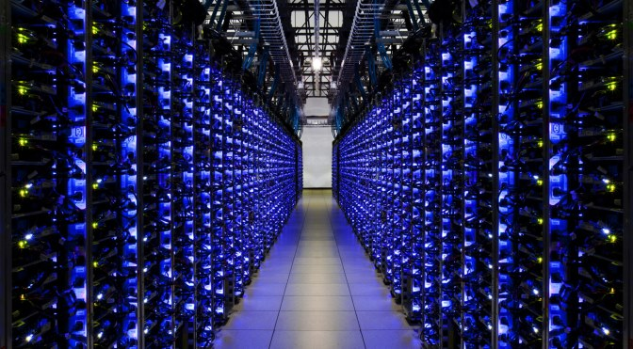







Resource management is ubiquitous
Cluster scheduling
Video streaming
Virtual machine placement
… ...
Congestion Control
Internet telephony
Notes:
Resource management is everywhere in computer systems.
Examples include:
--- Cluster scheduling, where we need to manage the resources of a large number of machines in a cluster and schedule jobs on them.
--- Video streaming on mobile devices, where we need to carefully adapt the bit rate to make use of the limited network resource.
--- And many other examples, like vm placement in the cloud, congestion control..
Such problems have been around for a long time, both in theory and practice, and yet resource management remains a significant challenge in computer systems.

Slide 3



An example: cluster scheduling
An online multi-resource allocation problem, e.g. CPU, memory
Competing factors to consider; NP-hard
Online decision depends on workload characteristics
Compute Resources
Pending jobs queue
Scheduler
Notes:
In this talk, I am going to focus on cluster scheduling in datacenters, as a concrete example of resource management.
Cluster scheduling is an online multi-resource allocation problem. In a computer cluster, each machine provides multiple type of resources, such as CPU and memory. Users continuously submit their jobs, and a scheduler must pick which jobs to run at each time, in order to optimize some objective, like minimizing job completion time or maximizing cluster utilization.
What is so difficult about this problem? Well, there can be competing factors to consider. For example to minimize completion time, you want to favor small jobs over big job. At the same time, you also want to consider the complementarity of resource requests to pack as many job as possible. These two factors can conflict with each other and it is hard to draw a balance. In fact, this problem is in general NP-hard.
Now, in practice imagine doing this online, where your observations of the cluster are noisy (OK to get rid of this if you want) and optimal decisions depend on the nature of the workload.

Slide 4

What people do today
Is there a way around human-generated heuristics?
Assume a simple model for the system
Come up with some clever heuristics
Painstakingly test and tune the heuristics in practice
Notes:
So, how do we solve such problems today?
It’s basically these 3 steps.
First we simplify the problem to something manageable.
Then we come up with some clever heuristics to solve the simplified problem, like SJF or various packing heuristics. And we hope the solution will carry over to the real system.
But the reality is, we usually have to do a lot of tweaking, and testing and tuning of parameters, to get things to work as expected.
And the whole process just repeats and repeats if we face a new problem or the workload changes.
I guess everyone who builds real system knows this pain.
Here we want to pause and ask, is there a way out of this loop? Is there a way around these human-generated heuristics?

Slide 5
Can systems learn to manage resources on their own?
Notes:
In other words, can systems learn to manage resources on their own?

Slide 6
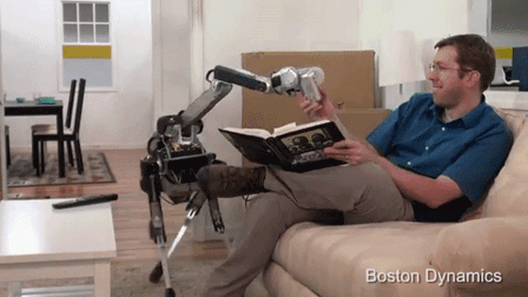

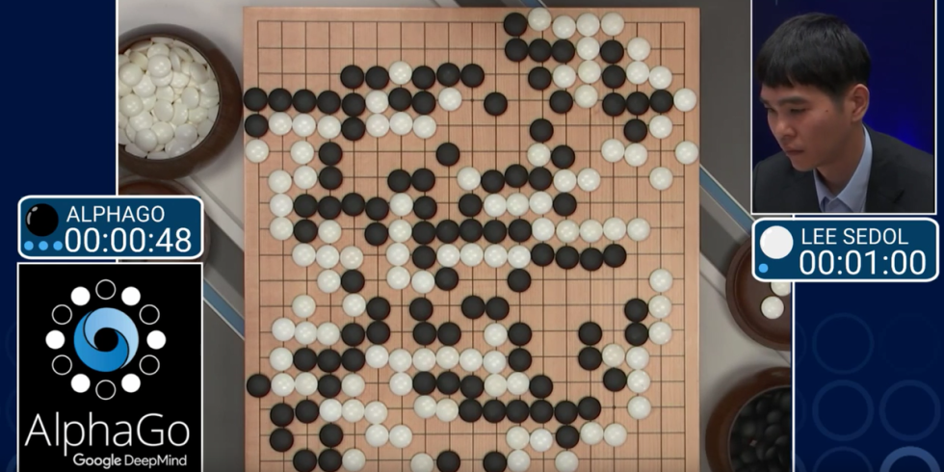
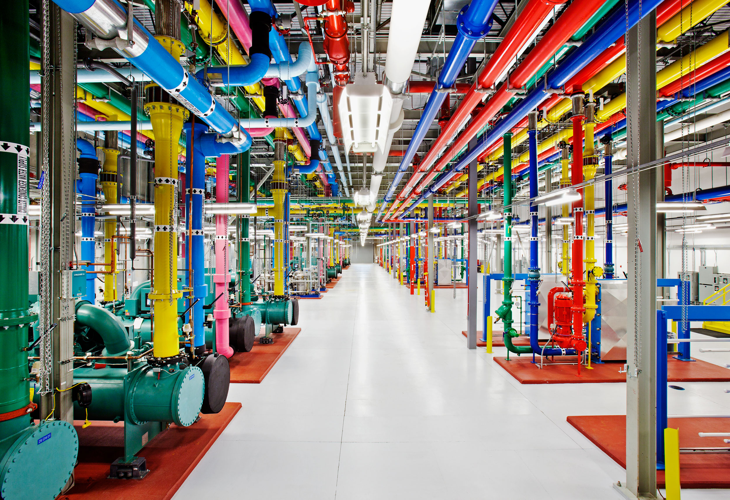
Successes of learning in decision making
Robotics control
Game of Go
Datacenter cooling
Learning via interacting with the environment: Reinforcement Learning
Notes:
This may sound like science fiction --- a system that learns to manage itself. But actually this vision is not that far fetched. In other fields, there are successes recently of learning for decision making in large and complex systems.
In robotics control, the complicated dynamics can be controlled so well that the robot behaves like a real animal.
For board games as complex as the game of Go, AI has defeated the best human champion in the history.
Just recently Google reported using learning to improve efficiency of their datacenter cooling systems significantly.
In fact, there is a whole area in Machine Learning that designs algorithms that learn to make better decisions by interacting with an environment. This is called Reinforcement Learning.

Slide 7
DeepRM
A cluster scheduling system that learns to make decisions directly from experience
Optimizes a variety of objectives end-to-end
Using Reinforcement Learning
Notes:
In this work, we built a cluster scheduling system called DeepRM, that learns to make scheduling decisions directly from experience
It can optimize for a variety of objectives, like minimizing job slowdown, maximizing cluster utilization, etc. end-to-end; meaning, without forcing the designer to specify any intermediate goals, like favoring short jobs over long jobs.
At its core, it uses Reinforcement Learning.

Slide 8
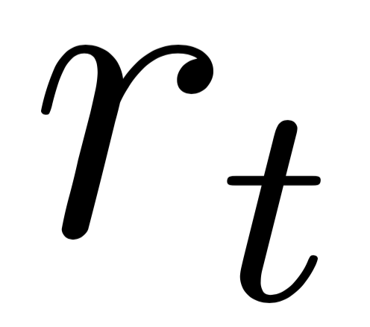
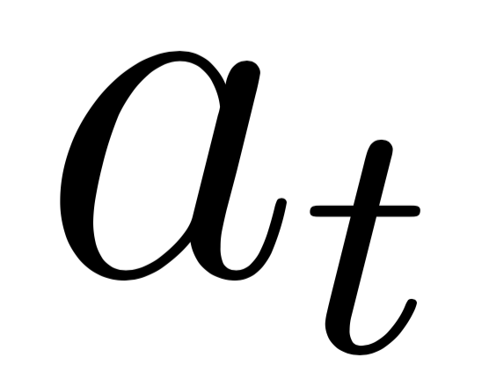
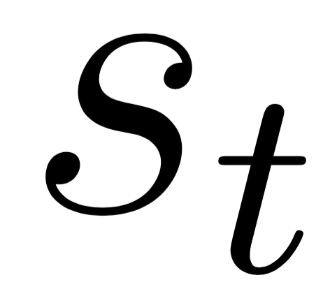
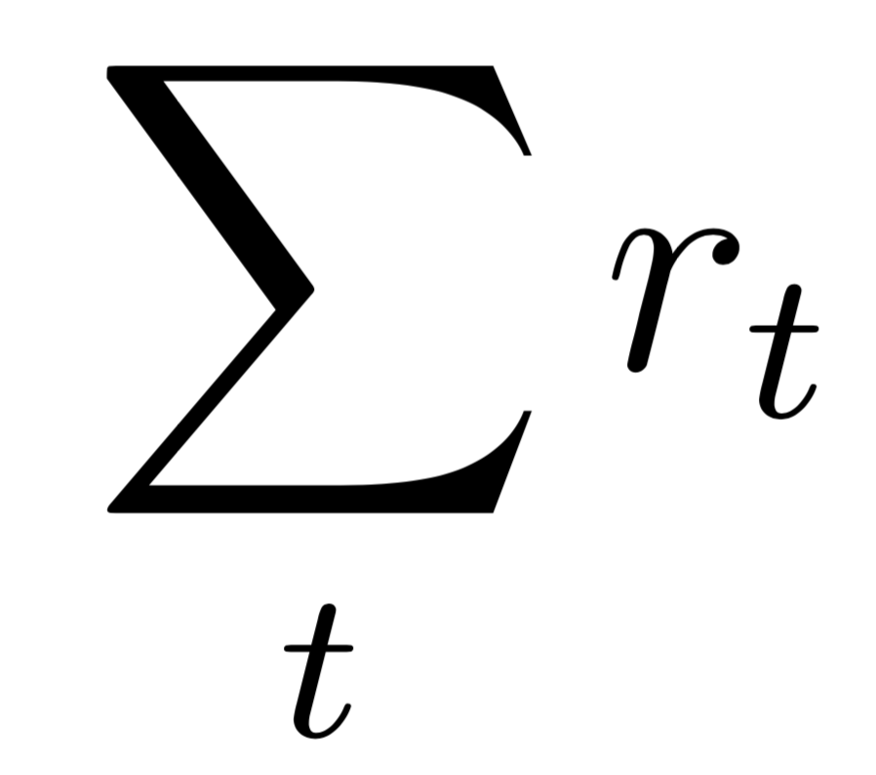
Reinforcement Learning
Reward
Take action
Agent
Environment
Observe state
Goal: maximize the cumulative reward
Notes:
Let me give you a quick 1 slide overview of Reinforcement Learning.
It is basically this few components. There is an environment and there is an agent. At each time step t, the agent observes the current state from the environment takes an action. Through this interaction, the environment gives the agent a reward signal that tells it how well it is doing. The goal of the agent is to maximize the total reward over time.

Slide 9
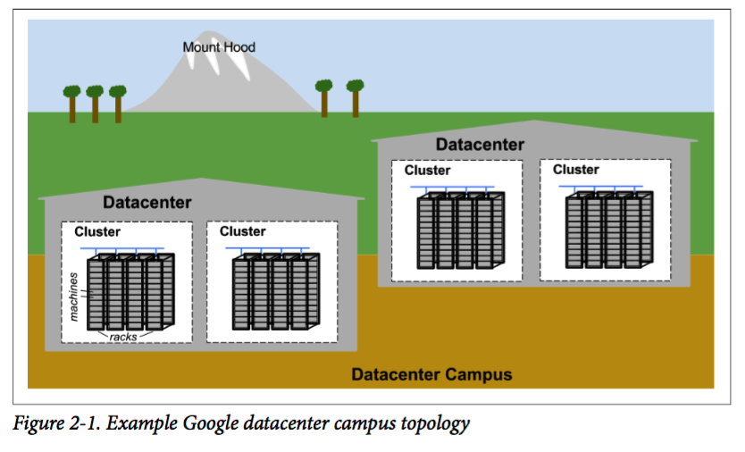
Google Data Center
Tens of machines are placed in a rack.
Racks stand in a row.
One or more rows form a cluster.
Usually a datacenter building houses multiple clusters.
Multiple datacenter buildings that are located close together form a campus.

Slide 10
Cluster scheduling problem setting
Cluster
Job Slots
Multi-resource allocation
Known resource requests
Non-preemptive
Goal: Minimize average
job_slowdown = job_duration / job_length
CPU
Time Time
Memory
Notes:
Now let me show you how we apply Reinforcement Learning to cluster scheduling.
The way we think of cluster is that it has multiple type of resources [click]
Like here, we have cpu and memory. In each of these two images, the horizontal dimension is for resource slots and we allocate job over time
Also, the scheduler sees a list of pending jobs.
[click] Now jobs come with known resource requests
For example, this red job takes 2 unit of CPU, 1 unit of memory and will take 3 units of time to complete. This purple job takes 1 unit of CPU, 2 unit of memory and 1 unit of time to finish.
A scheduler decides which job to schedule to the cluster, [click] say it allocates this red job.
As is common in practice, we assume the scheduling decisions are non-preemptive. Once the job is allocated, it holds the resource until it is completed.
[click] As a concrete objective that I will focus on in this talk, I am gonna assume the goal is to minimize average slowdown. The slowdown is defined to be actual duration of a job, divided by its intrinsic length. This is like a normalized completion time of the job.

Slide 11
Map to Reinforcement Learning
Reward
Take action
Agent
Environment
Observe state
Notes:
To map this problem to a Reinforcement Learning problem we need to define 3 aspects: what is the state in the environment, what sets of action to take, and what is the reward signal.
Let’s take a look of them one by one.

Slide 12

Map to RL: (1) state space
Cluster
Job Slots
Reward
CPU
Take action
Agent
Environment
Time Time
Memory
Observe state
Notes:
The state is simple. It is exactly the image I just described. The cluster space contains different colors for jobs currently running. And there is a pending job queue. These are the inputs to the scheduler agent.

Slide 13
Map to RL: (2) action space
Cluster
Job Slots
Reward
CPU
Take action
Agent
Environment
Time Time
Memory
Observe state
Challenge: explosion of the action space
Notes:
Now, what are the actions?
At every time step, the scheduler can pick any subset of the pending jobs to schedule.
A naive way of representing the action, is to pick any subset of the jobs to allocate. For example, the agent decides to allocate both the blue job and the yellow job. The challenge with this is that, when there are many jobs, picking any subset means a huge action space, which will make it harder to learn the best action.
We use a trick to keep the action space small.

Slide 14

Map to RL: (2) action space
Cluster
Job Slots
Reward
CPU
Move on
Take action
Agent
Environment
Time Time
Memory
Observe state
Solution: sequential allocation + “move on” action
Notes:
We break down the allocation decision at each time into a sequence of steps. And we introduce a special action called the move on action.
In each step, the agent picks a single job to run in the cluster and it will be allocated to the first available slot. [click]. Similar for this another yellow job.
After the agent picks all the jobs it wants to, it will choose the move on action to signal that it is done. The cluster now proceeds to work on the allocated jobs; in our simulated environment, the jobs in the cluster move up by 1 unit, simulating time passing by 1 unit.
This sequential allocation allows the agent to select any subset of pending job but the action space is only linear

Slide 15
Map to RL: (2) action space
Cluster
Job Slots
Reward
CPU
Move on
Take action
Agent
Environment
Time Time
Memory
Observe state
Solution: sequential allocation + “move on” action
Notes:
This sequential allocation allows the agent to select any subset of pending job but the action space is only linear

Slide 16
Map to RL: (3) reward signal
Objective:
minimize average job slow down = job_duration / job_len
Reward
Take action
=
sum over all time
Agent
Environment
Reward:
A penalty of -1 / job_len for every unfinished job
Observe state
The reward can be chosen to exactly match with the objective
Notes:
Now we get to choose what reward signal to use.
Remember our objective is average slowdown, the normalized job completion time.
Accordingly we give a penalty of -1/job length at each time step. Recall that the goal of RL is to maximize the total reward, when you sum over all the penalty over all time, it becomes exactly job duration. This reward signal is designed to exactly match the objective.
With all 3 components defined, let’s take a closer look at the learning agent, which really makes the scheduling decisions.

Slide 17
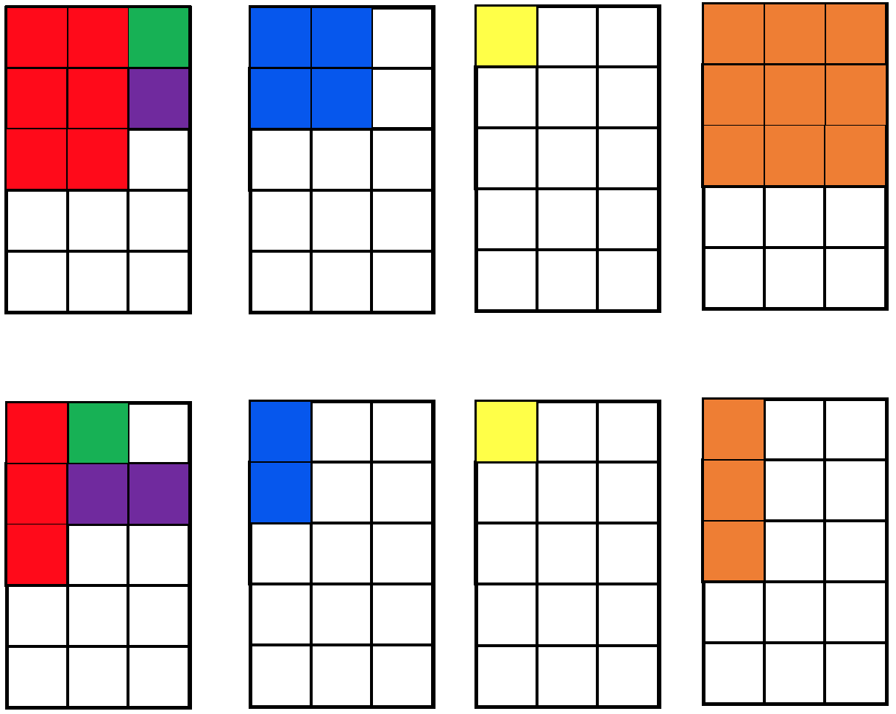

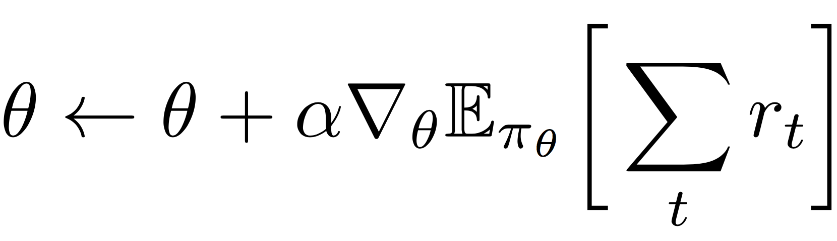
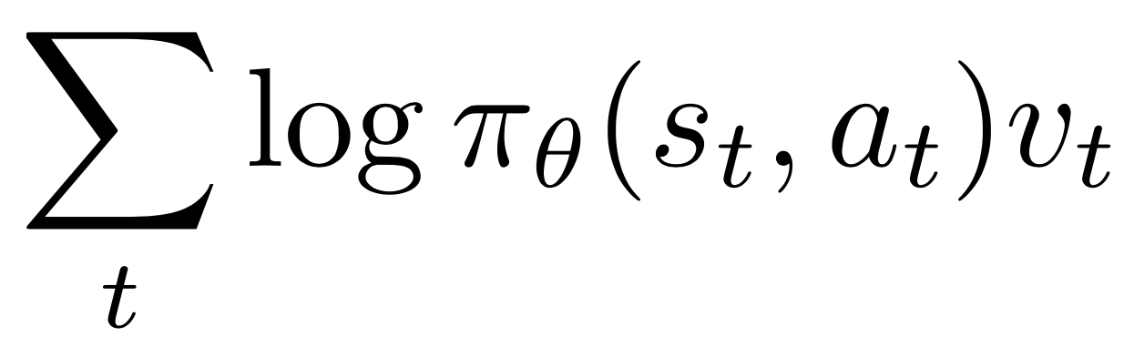
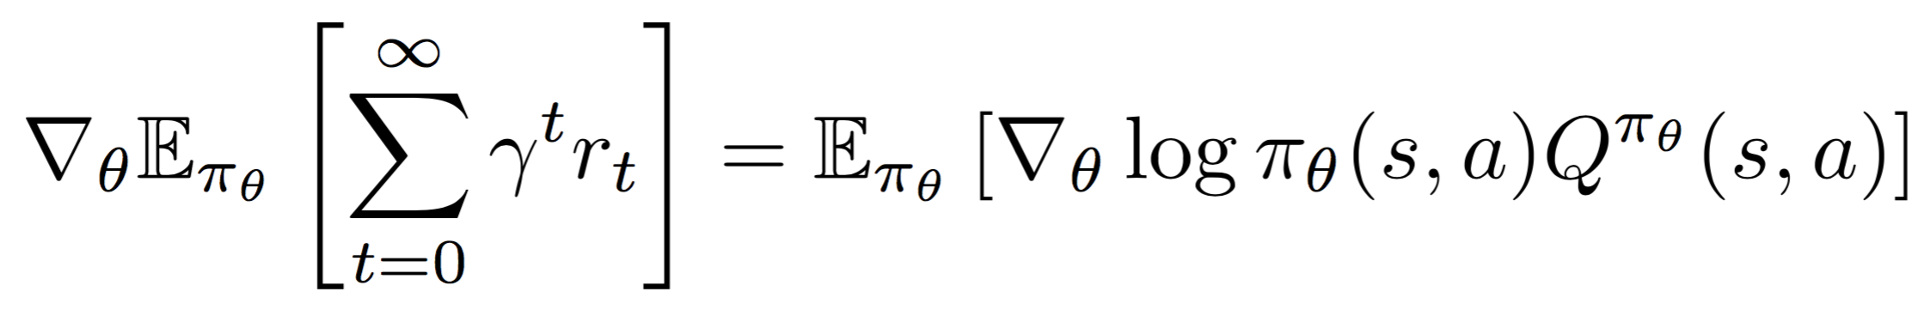
Reinforcement Learning agent
Reinforcement Learning agent
Deep Neural Network
policy
π_{θ}(s, a)
State s
Take action a
parameter θ
Policy gradient:
Calculate derivative to decide which direction
will lead to a higher log-likelihood of a_t action at s_t
estimate the returns
from experience
Notes:
Let’s open it up.
The agent takes the observed state as input, the images that I just described. It passes this through a deep neural network. The output of the neural net is a probability distribution over a set of actions. The neural net essentially encodes a scheduling policy.
Now how do we train this agent, how do we improve its scheduling policy?
Well we actually do standard gradient descent. Remember, the goal is to maximize total reward, we can take the gradient of the total reward and move the neural net parameter in the direction of the gradient.
[click] In practice, the gradient of total reward can be estimated from samples of experience, in this v_t term. [shouldn’t there be a sum over t in the formula?]
[click] The idea is you run the system, observe a trajectory of reward for different actions, and move the parameters in the direction that can increase the reward – basically, you increase the probability of actions that lead empirically to high rewards, and decrease the probability of actions that have low rewards.
The details are in the paper. Let me show you an example of how the agent learns.

Slide 18
DeepRM Demo
Notes:
This is a graph showing the learning behavior. X axis is the training iteration, y axis is our objective slowdown of jobs, the smaller the better. This is the learning curve of DeepRM. As we expected, it improves its performance as the training iteration increases.
For reference, we also plot a few other schemes as comparison. SJF is shortest job first. Packer is a heuristic that tries to pack as many jobs as possible in a scheduling run. Tetris* is a simplified variant of state-of-the-art Tetris scheduler from sigcomm 2014.

Slide 19
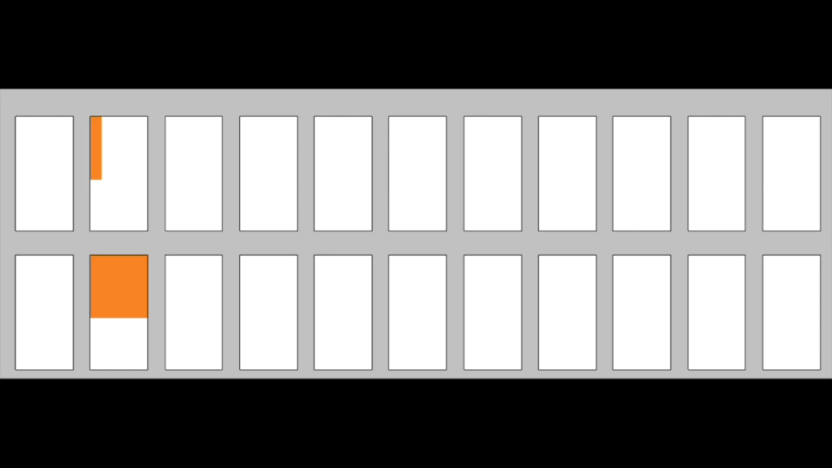


DeepRM Demo
Cluster
Job slots…
CPU
Time Time
Memory
Notes:
Now we zoom in on each training region and see what it does. This is a visualization of cluster state and pending jobs in our experiment.
Initially the parameters in the neural net is all random and therefore the policy is just random policy. As you can see, the agent just makes some completely random decision and the pending job queue quickly grows.
[click]
After a few iterations, something interesting happened. The agent figures out, oh this is a scheduling task. We’d better allocate a job when there is available resource. This is a non trivial step, keep in mind that we didn't tell anything to the agent about those blocks, what it means by allocating, what it means by available resource. It just figures itself out through experience.
[click]
After more training, it becomes"clever” enough to realize the objective has something to do with the size of the job, and it learns to favor small jobs over big jobs.

Slide 20
Evaluation
Notes:
Now because of the time constraints, I just briefly go over couple of highlights from our preliminary evaluation, there are more results in the paper.
Here we conduct a simulation on synthetic workloads. Finite bursts of jobs arrive at different levels of cluster loads.
We train DeepRM using a set of training workloads and let it converge to a scheduling policy. Then we compare it against with existing heuristics on a testing dataset, which consists of workload it hasn’t seen before, but drawn from the same distribution.
The graph here is slowdown on different cluster load.
It turns out DeepRM is able to perform similarly with other heuristics at low load, and performs notably better in higher load.

Slide 21
Where is the gain from
DeepRM is actually non work-conserving
Recall that scheduling is non-preemptive.
DeepRM Hold big jobs to make room for future small jobs
DeepRM learns this strategy purely from experience
Notes:
This makes us curious, where is the gain from?
Well, it turns out, besides favor small job over big job and do the packing, DeepRM is making non work-conserving decisions. This means it can hold a job even there is enough resource to alloocate it.
Why is that helping? Remember the allocation is non-preemptive
if you schedule a big job and the load is high, the future arriving small job may not have a chance to schedule. So it makes sense to hold some resource.
DeepRM knows sometimes the better strategy is to hold a big job to make room for incoming future small jobs.
It picks up both this trick and the characteristics of workload that it has a mixture big and small job in the workload. DeepRM does this purely from experience. We did not inject our willing in any way here.

Slide 22
Conclusions
Learning system for cluster scheduling
DeepRM’s algorithms are applicable to other problems
Challenges:
How do humans interpret the policy?
Work with non-stationary workloads?
Safety issues, what if it goes wrong?
....
Notes:
So, we’ve built a preliminary learning system for cluster scheduling, that improves its scheduling decisions through experience.
The reinforcement learning algorithms behind DeepRM is general, and it can be applied to other resource management problem in computer systems as well.
There are also challenges with such approaches. For example, how can human interpret the policy the learning agent learns? The heuristics are easier to understand but the machine generated policy can be much harder to understand. Remember, the policy is generated by a bunch of neural network, how can we understand why the agent makes some action?
Also, how responsive is the learning agent? Our evaluation is for a stationary workload. How quickly would it adapt in a non-stationary environment?
And as common concerns with AI, how do we cope with safety issues here? If the agent starts behaving strangely, how do we ensure there is a safety net or fallback? How can we control the risks?
Because this approach is new, we have lots of unknowns here. But we believe systems like DeepRM that learn to manage resources on their own have a lot of potential.
With that, I am happy to take questions.

Slide 23
Tailor for different objectives

